Slide 1
Telemedicine
Block diagram of telemedicine system, origin and development of Telemedicine, Benefits, and limitations of Telemedicine.

Slide 2
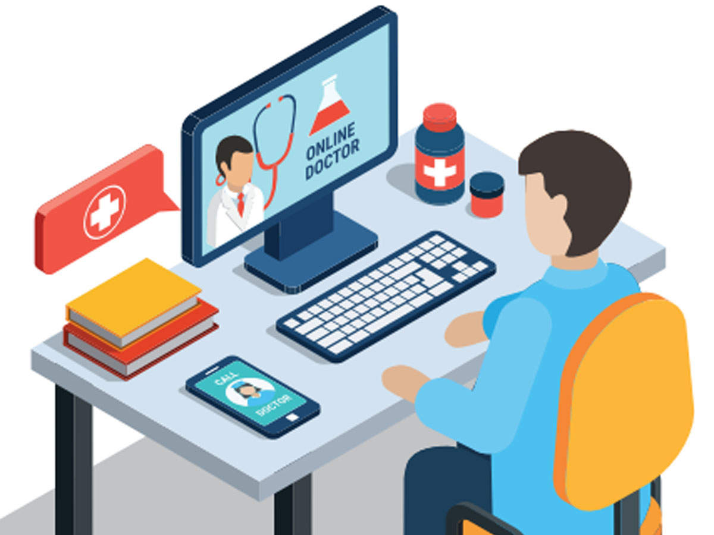
Telemedicine
The World Health Organization (WHO) defines Telemedicine as,
“The delivery of healthcare services, where distance is a critical factor, by all healthcare professionals using information and communication technologies for the exchange of valid information for diagnosis, treatment and prevention of disease and injuries, research and evaluation and for the continuing education of healthcare providers, all in the interests of advancing the health of individuals and their communities.”

Slide 3
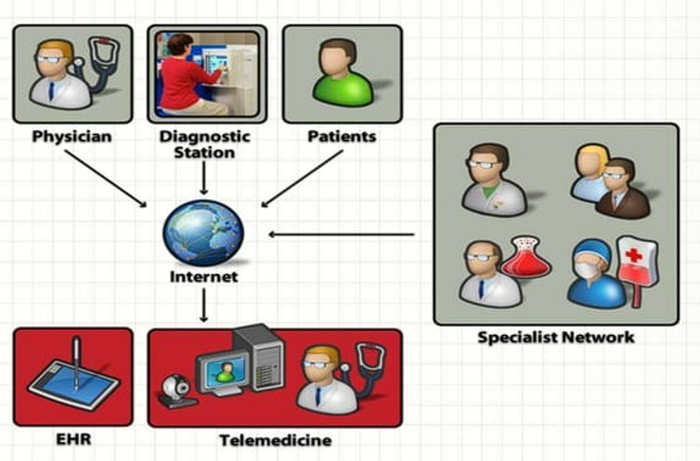
Telemedicine
Telemedicine is the use of telecommunication and Information technology in order to provide clinical health care at a distance.
It helps eliminate distance barriers and can improve access to medical services that would often not be consistently available in distant rural communities.

Slide 4
Telemedicine System
The Telemedicine system consists of an interface between hardware, software and a communication channel to eventually bridge two geographical locations to exchange information and enable teleconsultancy between two locations.
The hardware consists of a computer, printer, scanner, videoconferencing equipment etc. The software enables the acquisition of patient information (images, reports, films etc.). The communication channel enables the connectivity whereby two locations can connect to each other.

Slide 5
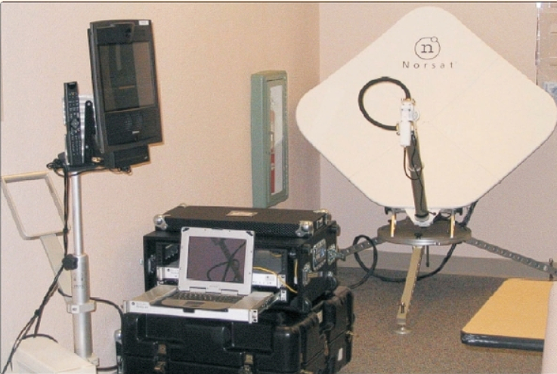
Telemedicine system

Slide 6
History of Telemedicine
While the explosion of interest in telemedicine over the past four or five years makes it appear as a relatively new use of telecommunications technology, the truth is that telemedicine has been in use in some form or the other for over thirty years.
The National Aeronautics and Space Administration (NASA) played an important part in the early development of telemedicine.
NASA's efforts in telemedicine began in the early 1960s when humans began flying in space. Physiological parameters were transmitted from both the spacecraft and the space suits during missions

Slide 7
One of the earliest endeavors in telemedicine, Space Technology Applied to Rural Papago Advanced Health Care (STARPAHC) delivered medical care to the Papago Indian Reservation in Arizona. It ran from 1972–1975 and was conceived by the NASA
The Apollo group of hospitals was a pioneer in starting a pilot project at a secondary level hospital in a village called Aragonda 16 km from Chitoor (population 5000, Aragonda project) in Andhra Pradesh.
Starting from simple web cameras and ISDN telephone lines today, the village hospital has a state-of-the-art videoconferencing system and a VSAT (Very Small Aperture Terminal) satellite installed by ISRO (Indian Space Research Organisation).

Slide 8
In India, telemedicine programs are actively supported by:
Department of Information Technology (DIT)
Indian Space Research Organization
NEC Telemedicine program for North-Eastern states
Apollo Hospitals
Asia Heart Foundation
State governments
Telemedicine technology also supported by some other private organizations

Slide 9
Benefits of Telemedicines
Easy access to remote areas
Using telemedicine in peripheral health set-ups can significantly reduce the time and costs of patient transportation
Monitoring home care and ambulatory monitoring
Improves communications between health providers separated by distance
Critical care monitoring where it is not possible to transfer the patient
Continuing medical education and clinical research
A tool for public awareness
A tool for disaster management
Second opinion and complex interpretations
The greatest hope for use of telemedicine technology is that it can bring the expertise to medical practices once telecommunication has been established.
Telementored procedures-surgery using hand robots
Disease surveillance and program tracking

Slide 10
Type of Technology
Two different kinds of technology make up most of the telemedicine applications in use today.
The first, called store and forward, is used to transfer digital images from one location to another. A digital image is taken using a digital camera, ‘stored’ and then sent (‘forwarded’) by a computer to another location. This is typically used for nonemergent situations, when a diagnosis or consultation may be made in the next 24-48 hours and sent back. Teleradiology, telepathology and teledermatology are a few examples.
The other widely used technology, the two-way interactive television (IATV), is used when a ‘face-to-face’ consultation is necessary. The patient and sometimes their provider or more commonly a nurse practitioner or telemedicine coordinator (or any combination of the three), are at the originating site. The specialist is at the referral site, most often at an urban medical center. Videoconferencing equipment at both locations allow a ‘real-time’ consultation to take place. Almost all specialties of medicine have been found to be conducive to this kind of consultation including psychiatry, internal medicine, rehabilitation, cardiology, pediatrics, obstetrics and gynecology and neurology.

Slide 11
Infrastructure
The telemedicine centers could be broadly classified into the following classes:
Primary Telemedicine Center (PTC)
Secondary Telemedicine Center (STC)
Tertiary Telemedicine Center (TTC)
PTCs would be based in Primary Health Centers, STCs in Secondary Medical Centers and TTCs in Tertiary Medical Centers.

Slide 12
Telecommunication Technologies
The first among the challenging questions arising when planning a telemedicine network is ‘What is bandwidth?’ Bandwidth is the capacity that determines how quickly bits may be sent down the channels in a telecommunication medium. Bandwidth is proportional to the complexity of the data for a given level of system performance.
Integrated Services Digital Network : nearly five times the fastest rate achievable using analog modems over POTS
T-1 : voice and data digitally at 1.554 megabits per second (Mbps)
Plain Old Telephone Service (POTS): 56 kilobits per second
Internet

Slide 13
Application of Telemedicine in Public Health
An epidemiological Surveillance
It can give new insight into geographical distribution and gradients in disease prevalence and incidence and valuable insight into population health assessment.
It also provides valuable information of differential populations at risk based on risk factor profiles.
It helps in differentiating and delineating the risk factors in the population.
It also helps in interventional planning, assessment of various interventional strategies and their effectiveness.
It can play a pivotal role in anticipating epidemics.
It is an essential tool in real-time monitoring of diseases, locally and globally.
GIS provides the basic architecture and analytical tools to perform spatial-temporal modeling of climate, environment and disease transmission helpful in understanding the spread of vector-borne diseases. Remote sensing techniques have been recently been used in this regard.
A GIS-based method for acquiring, retrieving, analyzing and managing data differs from traditional modes of disease surveillance and reporting. It facilitates aggregation and integration of disparate data from diverse sources so it can guide the formulation of public health programs and policy decisions.

Slide 14
Application of Telemedicine in Public Health
Interactive health communication and disease prevention
It can relay information to individuals as well as to the population as a whole. It can provide an easy access to those living in remote areas.
It enables informed decision-making. It also simplifies the health decision-making process / or communication between healthcare providers and individuals regarding prevention, diagnosis or management of a health condition. As a result, the users are exposed to a broader choice base.
It can go a long way to promote and maintain healthy behaviors in the community.
It can also help in peer information exchange and emotional support. Examples include online Internet applications that enable individuals with specific health conditions, needs or issues to communicate with each other, share information and provide / receive emotional support.
It promotes self-care and domiciliary care practices. Many living in the remote areas can be benefited by self-management of health problems which will supplement existing health care services.
It can be a very important tool for the evaluation and monitoring of healthcare services.

Slide 15
Challenges
Perspective of medical practitioners: Doctors are not fully convinced and familiar with e-medicine.
Patients' fear and unfamiliarity: There is a lack of confidence in patients about the outcome of e-Medicine.
Financial unavailability: The technology and communication costs being too high, sometimes make Telemedicine financially unfeasible.
Lack of basic amenities: In India, nearly 40% of population lives below the poverty level. Basic amenities like transportation, electricity, telecommunication, safe drinking water, primary health services, etc. are missing. No technological advancement can change anything when a person has nothing to change.
Literacy rate and diversity in languages: Only 65.38% of India's population is literate with only 2% being well-versed in English.
Technical constraints: e-medicine supported by various types of software and hardware still needs to mature. For correct diagnosis and pacing of data, we require advanced biological sensors and more bandwidth support.
Quality aspect: “Quality is the essence” and every one wants it but this can sometimes create problems. In case of healthcare, there is no proper governing body to form guidelines in this respect and motivate the organizations to follow-it is solely left to organizations on how they take it.
Government Support: The government has limitations and so do private enterprises. Any technology in its primary stage needs care and support. Only the government has the resources and the power to help it survive and grow. There is no such initiative taken by the government to develop it.

